Slide 1
Bernard Becker Medical Library
Delivering knowledge, informing decisions

Slide 2

Welcome to Computing Basics
Box link to workshop materials: https://wustl.box.com/s/4y06dtlhb9nhxrwco34awt3nf0ijgelk
During the session, type your questions in the chat box. If we don’t get to answer your question today, we’ll follow up with you after the workshop

Slide 3
Computing Basics
Maze Ndukum
ndukummaze@wustl.edu
Sr. Support Scientist
Research Services
Becker Medical Library
Elyn Fritz-Waters
elyn@wustl.edu
HPC Research Facilitator
Research Infrastructure Services
WashU Information Technology

Slide 4
Computing Basics Workshops
Open On Demand on RIS Scientific Compute Platform – 4/10/2024, 1 PM – 2:30 PM
OOD is a web-based interface for connecting to and working in high performance computing environments. Attendees will learn how to run jobs using Open On Demand (OOD) on the RIS scientific compute platform.
The Unix Shell and Command Line Basics​ – 4/17/2024, 1 PM – 2:30 PM
Unix command line interface, the Unix file system, and basic Unix commands. Attendees will learn to create, explore, and manage Unix files and folders.
Software Applications Used in High Performance Computing Environments – 4/24/2024, 1 PM – 2:30 PM
Text editors, shell and batch scripts, Docker container technology, and the SSH protocol. Attendees will learn how to write, edit, and run shell scripts, how to create a simple Docker container, and how to connect to the RIS compute platform.
Submitting Jobs to RIS Scientific Compute Platform – 5/1/2024, 1 PM – 2:30 PM
Basic commands for submitting jobs to the queue on the RIS compute platform via the command line. Attendees will learn how to submit and run jobs/tasks using Docker and queuing system commands.
https://becker.wustl.edu/services/research-computing/
Notes:
This series provides the basics, and prepares those new to remote computing for ongoing learning
1. With the RIS OOD web interface, RIS users can use point-and-click options to connect to and interact with RIS compute resources, and access a variety of software for running jobs on the RIS Scientific compute platform.

Slide 5
RIS Scientific Compute
Research Infrastructure Services (RIS) provides high performance computing (HPC) resources for large-scale data management and data analysis
RIS: https://ris.wustl.edu/
Notes:
Other HPC clusters on campus:
- Research Computing and Informatics Facility (RCIF): https://www.mir.wustl.edu/research/core-resources/research-computing-and-informatics-facility/
- High Throughput Computing Facility @ CGS_SB (HTCF): https://htcf.wustl.edu/docs/

Slide 6
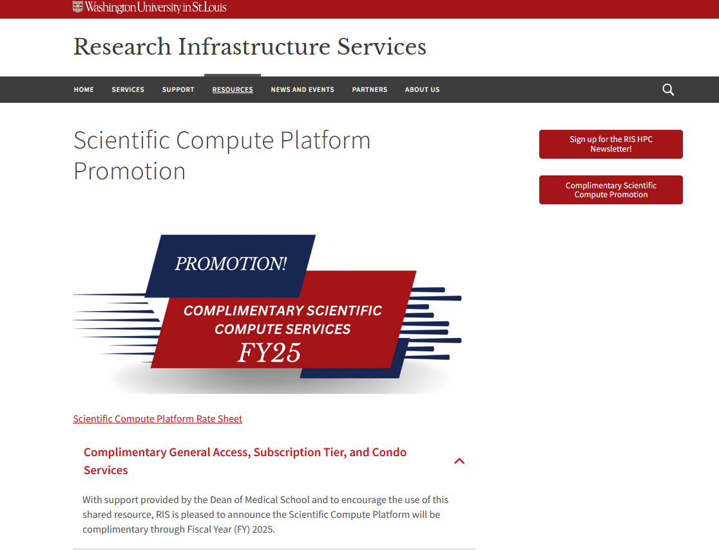
Notes:
Other HPC clusters on campus:
- Research Computing and Informatics Facility (RCIF): https://www.mir.wustl.edu/research/core-resources/research-computing-and-informatics-facility/
- High Throughput Computing Facility @ CGS_SB (HTCF): https://htcf.wustl.edu/docs/

Slide 7
Why use a compute cluster?
Large-scale data analysis can be complicated, computationally intensive that may not be very suitable on personal computers
Computing tasks normally done on personal computers can be done on computing clusters more efficiently and for a much shorter amount of time.
Computing clusters are great to speed up tasks, automate tasks and when several rounds of testing is needed
Notes:
Workflow on compute clusters:
Transfer your data onto the cluster from elsewhere or access/mount your data from a storage location that integrates with the cluster
Generate a batch script or implement container tools (Docker), which will tell the system how to process your data and manage input and output

Slide 8
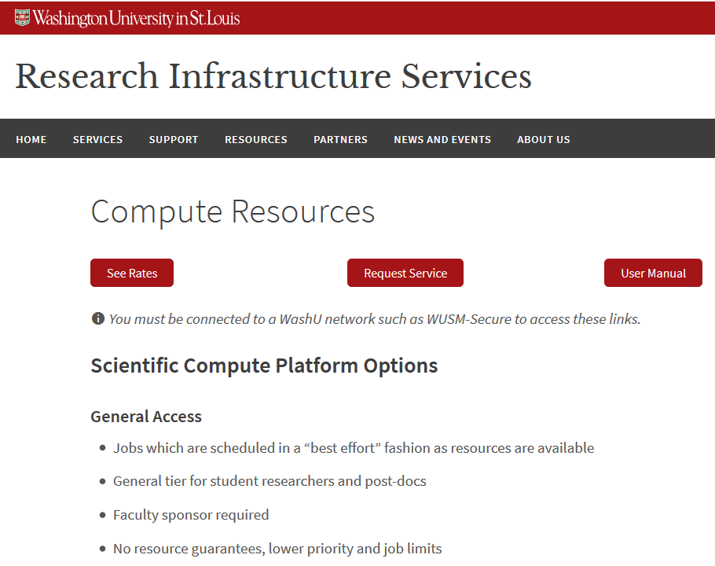
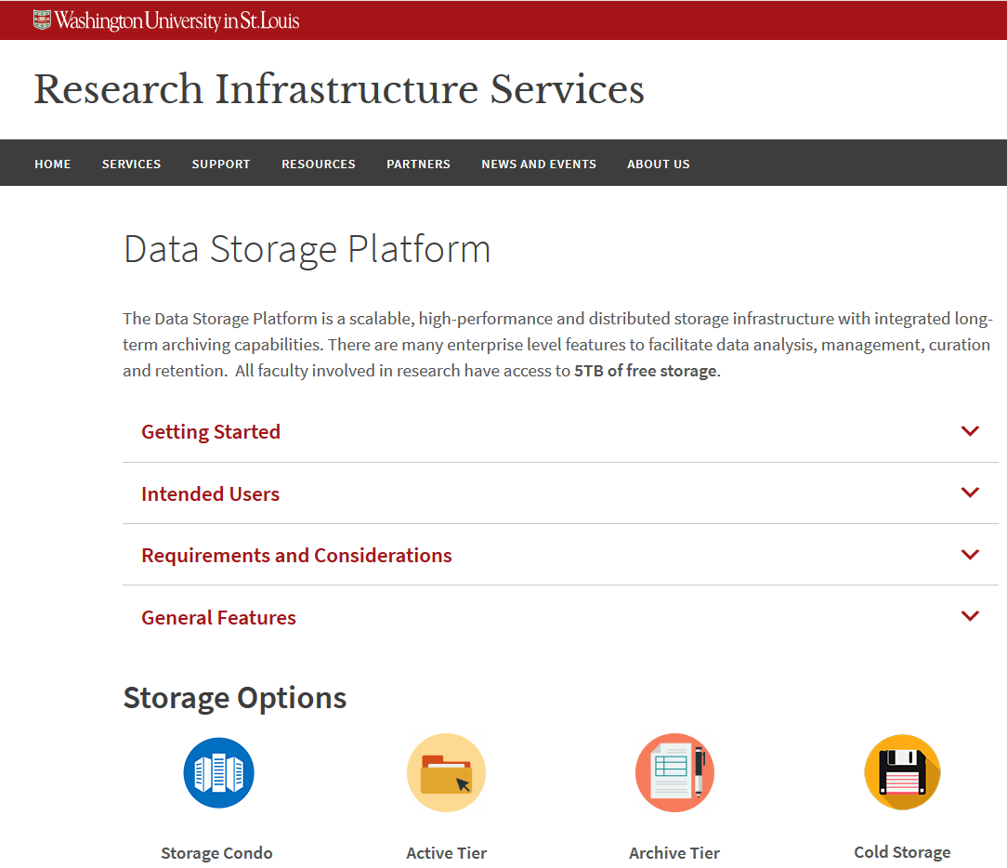
RIS storage and compute services
https://ris.wustl.edu/services/compute/resources/
https://ris.wustl.edu/services/research-storage/
Notes:
Compute and Storage: https://docs.ris.wustl.edu/doc/policies-user-agreement.html

Slide 9
RIS storage and compute services
WashU PIs can request access to storage and compute from here: https://servicedesk.ris.wustl.edu/
Helpful Resources: https://ris.wustl.edu/resources/
- Knowledge base articles
- User manuals
- Workshops and training events
- Grants proposal support
- Policies
Notes:
Compute Quick Start: https://docs.ris.wustl.edu/doc/compute/compute-quick-start.html

Slide 10
Main components of a compute cluster
High performance computing (HPC) clusters have more computing resources CPU, GPU, RAM, storage, etc., than laptops/local desktop.
Users need to connect to login nodes on the HPC (remote computer), in order to submit jobs to the HPC compute nodes for execution using commands or using a web interface such as Open On Demand (OOD)
Notes:
Users either have Linux or Mac, or Windows Operating System on their laptop/computer (local computer), a local laptop/computer with Linux command line interface (CLI), and basic Unix knowledge are required.

Slide 11
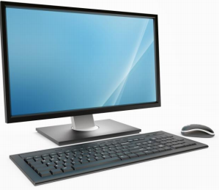


Main components of a compute cluster
User/local computer
Batch Job Scheduler software:
- RIS compute uses IBM’s Spectrum Load Sharing Facility (LSF)
login nodes
RIS compute uses Docker containers:
high-speed internet
Docker container images and LSF tells the RIS compute system how to process the jobs.
Use commands or Open On Demand web interface
compute nodes
storage
Notes:
A high performance computing cluster is basically multiple computers set up to work together in a way that they are viewed as a single unit (computer). Includes: job scheduler, high speed internet, server, nodes (storage, login, compute)
Needs ssh protocol (installed on users personal computer) to connect/interact with computer cluster
The RIS Scientific compute’s Batch Job Scheduler software, runs large scale, parallel computing tasks with access to many CPU and GPU cores, large amounts of RAM, high-speed networks, and high-performance storage systems. A user logs on and lands on login nodes, submits job to compute node for execution. RIS uses container technology (docker) and job scheduler/queue system to submit, manage jobs/tasks input, execution and output. High speed internet network is essential for this interaction

Slide 12
Today’s Workshop
Open On Demand on RIS Scientific Compute Platform – 4/10/2024
Open On Demand (OOD) is a web-based interface for connecting to and working in high performance computing environments.
Goal: learn how to run jobs using OOD on RIS scientific compute.
Notes:
Presentation:
What is OOD? Connect to and navigate RIS OOD
How to submit jobs that launch software apps
Demonstration Exercises:
Connect to RIS compute using ssh protocol
Start RIS OOD, launch the interactive apps

Slide 13
What is Open On Demand (OOD)?
OOD is a GUI interface for remote computing, it provides a web browser interface for users to connect to and interact with RIS compute resources
OOD website: https://openondemand.org/.
Access documents, ask questions, join discourse on the OOD support page: https://openondemand.org/support

Slide 14
RIS Open On Demand (OOD)
RIS ODD is a great place for new users to start, especially those who need some software (R, Python, MATLAB..) access on RIS Scientific compute
Users must first connect to RIS Scientific compute platform using the ssh protocol on command line interface (CLI) at least once
RIS OOD:
https://docs.ris.wustl.edu/doc/compute/compute-ood.html
https://docs.ris.wustl.edu/doc/compute/compute-quick-start.html
Notes:
After using ssh protocol to connect to RIS compute on CLI once, going forward, users can log on to RIS OOD using single sign on with wustl key without need for VPN

Slide 15
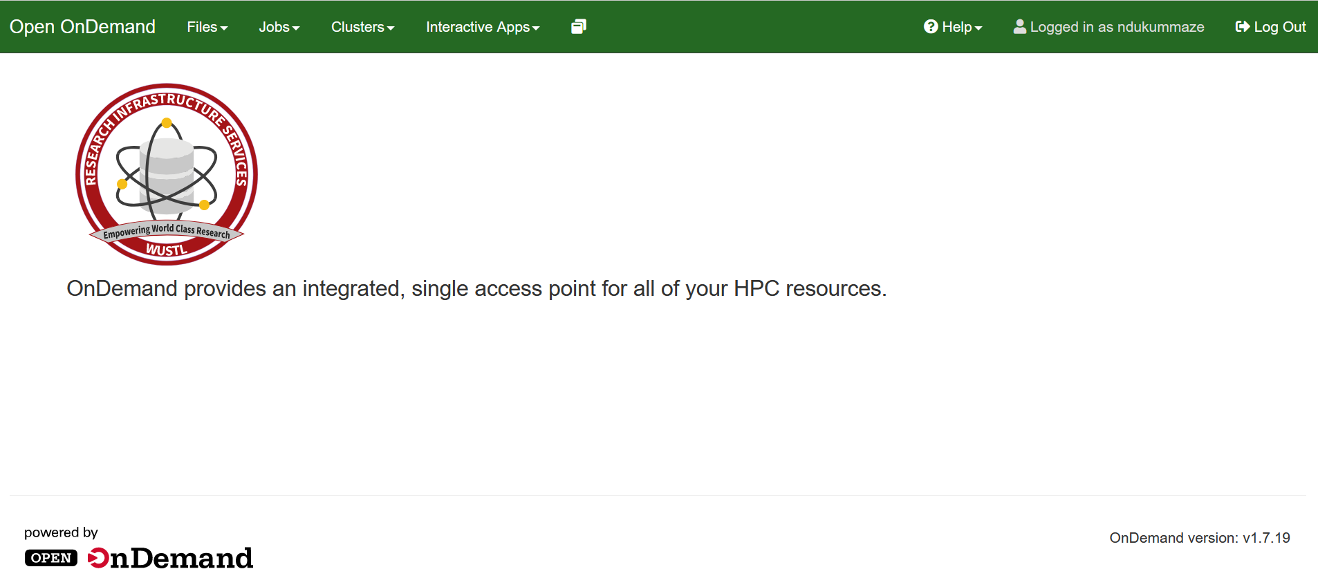
RIS Open On Demand (OOD)
Click http://ood.ris.wustl.edu
Notes:
OOD can:
display files and directories in your home directory not in storage 1 or scratch 1
Show active jobs – pending and running jobs
View job details and kill job if needed
Create and launch batch jobs similar to using a command on commandline like .bsub job file. Job and resource parameter information can be found on the Job Execution Examples page in RIS manual.
Jobs can be created from: - Default template - Specified path - Existing job (running or completed).

Slide 16
Secure SHell (SSH) protocol
Secure way to connect local computer to remote computers (HPC clusters)
CLI version of SSH is built-in for Linux and Mac computers
SSH Options for Windows :
- Windows PowerShell
- Windows Subsystem for Linux (WSL) installation
- PuTTY – https://www.putty.org
- MobaXterm – http://mobaxterm.mobatek.net/
Notes:
SSH protocol:
Secure way to connect local computer to remote computers (HPC clusters)
A variety of software options are available for SSH protocol implementation
Needs a username and password or an SSH key-pair to be able to connect

Slide 17
Connect to RIS Scientific Compute Platform
Basic ssh command to connect to an HPC cluster:
ssh USERNAME@MACHINE-ID
Connect to RIS Scientific Compute Platform:
ssh wustlkey@compute1-client-1.ris.wustl.edu
Password: wustlkey password
NOTE: VPN is needed for off-campus access
Notes:
To connect to the HPC cluster, type the ssh command in CLI prompt on the users local/personal computer and run it

Slide 18
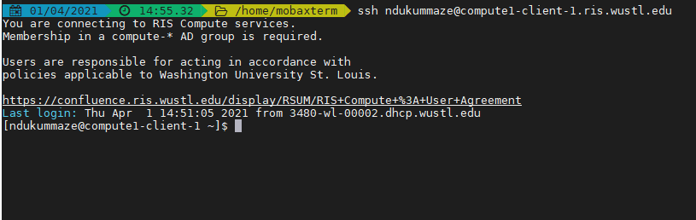
Connect to RIS Scientific Compute Platform
ssh ndukummaze@compute1-client-1.ris.wustl.edu
Password: Maze’s wustlkey password
Notes:
Connection to RIS Scientific Compute Platform:
- provides access to storage, CLI shell, OOD and much more…
- can use commands on CLI shell to create, explore and manage file/directories and to submit jobs

Slide 19
Connect to RIS Scientific Compute Platform
RIS scientific compute platform integrates with storage platform
Users can map storage as a drive on their local computer:
https://docs.ris.wustl.edu/?_ga=2.40306914.1528752349.1698870866-1910493063.1698860805#ris-data-storage-platforms
Can transfer files to and from your storage allocation (use smb protocol or globus for large files) https://docs.ris.wustl.edu/doc/storage/03_storage.html?highlight=mount%20storage
Notes:
Home directory is not backed up, compute work uses Home directory, but data and software need to be stored in cluster storage which is access in storage1 and scratch1

Slide 20
Connect to RIS Scientific Compute Platform
RIS account group names are assigned for a PI’s/ lab, group names are important for accessing storage1 and submitting jobs.
Maze's RIS group names:
Storage : storage-becker-library-test
Compute: compute-becker-library-test
Mounts – use the linux format:
/storage1/fs1/${STORAGE_ALLOCATION}/Active:/storage1/fs1/{$STORAGE_ALLOCATION}/Active${STORAGE_ALLOCATION}

Slide 21
What does batch job scheduler do?
The Batch Job Scheduler software on RIS compute platform is called LSF (Load Sharing Facility), it submits jobs, manages resources to run jobs and monitors progress of jobs
Job scheduler needs to manage all jobs (sometimes hundreds or thousands of jobs at any given time), decide which nodes to run which jobs on and balance the varied needs of individual users

Slide 22
RIS compute uses Docker containers
Docker containers are basically applications – they include code, software with any needed dependencies, and an operating system
RIS scientific compute uses Docker containers
Using Docker on RIS Scientific Compute Platform: https://docs.ris.wustl.edu/doc/compute/workshops/ris-docker-workshop.html#using-a-docker-container-on-the-compute-platform
Notes:
RIS docker images run in the background, users don’t have to create their own if they can use RIS images

Slide 23
Using ODD on RIS Scientific Compute Platform
RIS-hosted images: https://docs.ris.wustl.edu/doc/compute/recipes/ris-supported-containers.html
RIS-Vetted Application Containers: https://docs.ris.wustl.edu/doc/compute/recipes/ris-vetted-compute-apps.html#
Notes:
- RIS-hosts and maintains several docker images that have been created in collaboration with users.
- RIS-Vetted images have been tested to start a shell in an interactive job and confirmed working at the time of testing.
- Recommended to use RIS images if possible because non-RIS hosted images have not been tested and level of security is not guaranteed

Slide 24
Using ODD on RIS Scientific Compute Platform
Click http://ood.ris.wustl.edu
Notes:
Only need a web browser, can be on or off campus to connect.
Doesn’t need to be on WashU network after connecting to RIS compute using ssh connect at least once before

Slide 25
Using ODD on RIS Scientific Compute Platform
Click http://ood.ris.wustl.edu
Notes:
OOD can:
display files and directories in your home directory not in storage 1 or scratch 1
Show active jobs – pending and running jobs
View job details and kill job if needed
Create and launch batch jobs similar to using a command on commandline like .bsub job file. Job and resource parameter information can be found on the Job Execution Examples page in RIS manual.
Jobs can be created from: - Default template - Specified path - Existing job (running or completed).

Slide 26
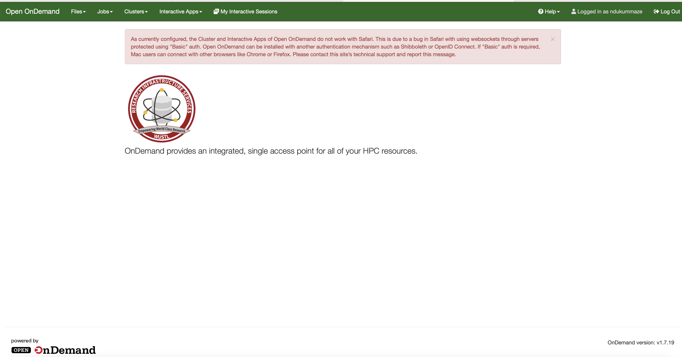
Using ODD on RIS Scientific Compute Platform
Click http://ood.ris.wustl.edu
OOD doesn’t work on Safari, use a different web browser (Google chrome or Mozilla Firefox)
Notes:
OOD can:
display files and directories in your home directory not in storage 1 or scratch 1
Show active jobs – pending and running jobs
View job details and kill job if needed
Create and launch batch jobs similar to using a command on commandline like .bsub job file. Job and resource parameter information can be found on the Job Execution Examples page in RIS manual.
Jobs can be created from: - Default template - Specified path - Existing job (running or completed).

Slide 27
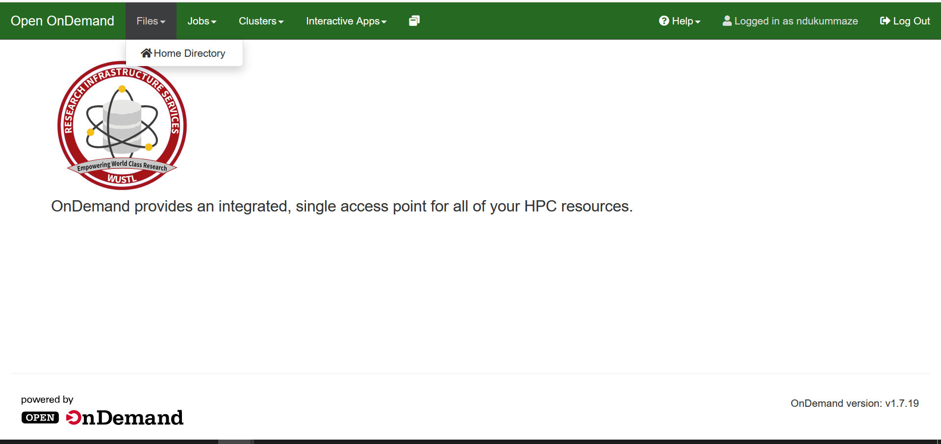
Using ODD on RIS Scientific Compute Platform
Notes:
Navigate your home directory, it’s the default location when OOD launches

Slide 28
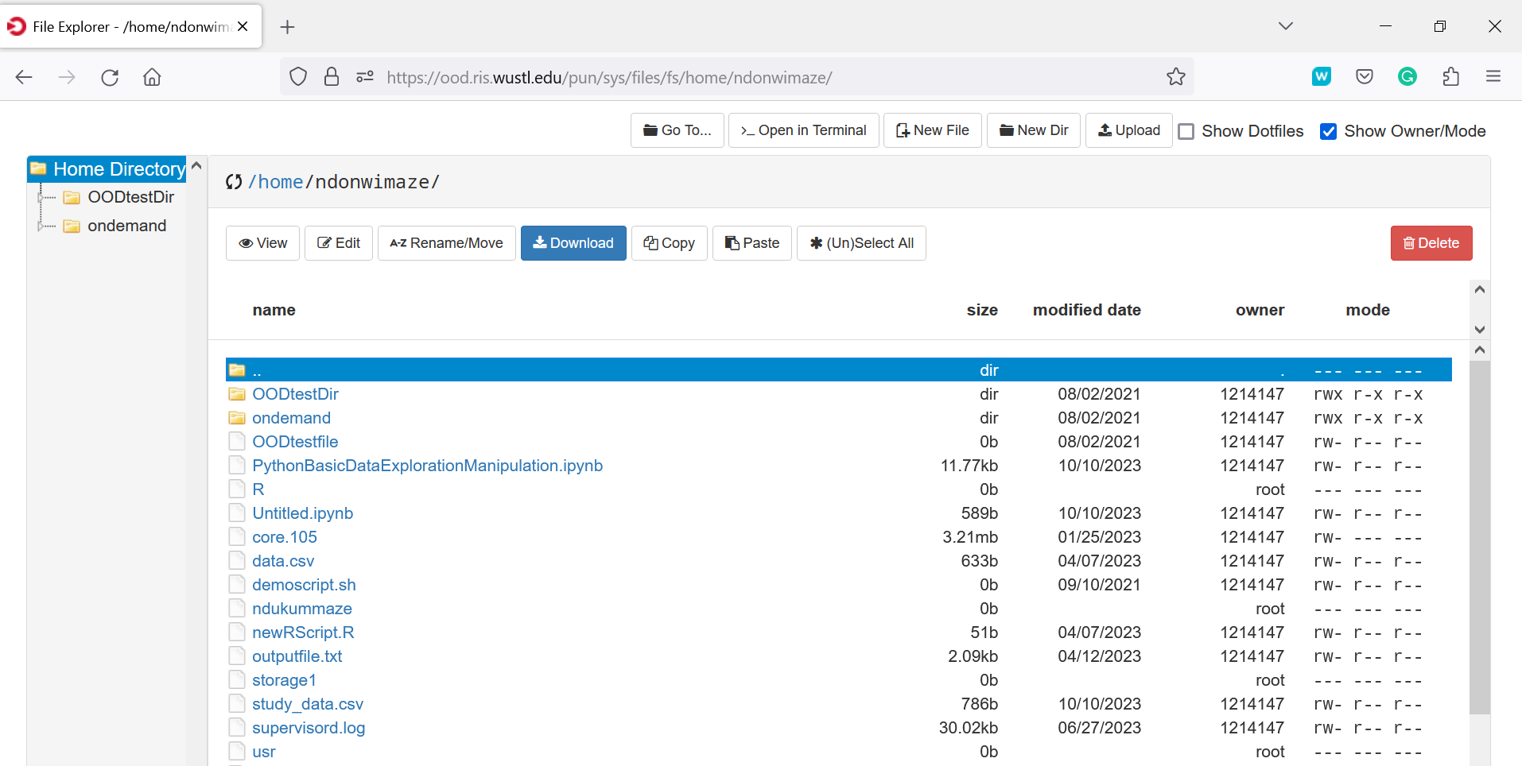
Using ODD on RIS Scientific Compute Platform
Notes:
Can view files, permissions for file owners (read/write/execute (x)), additional details about the files
Can access terminal in OOD, upload files etc

Slide 29
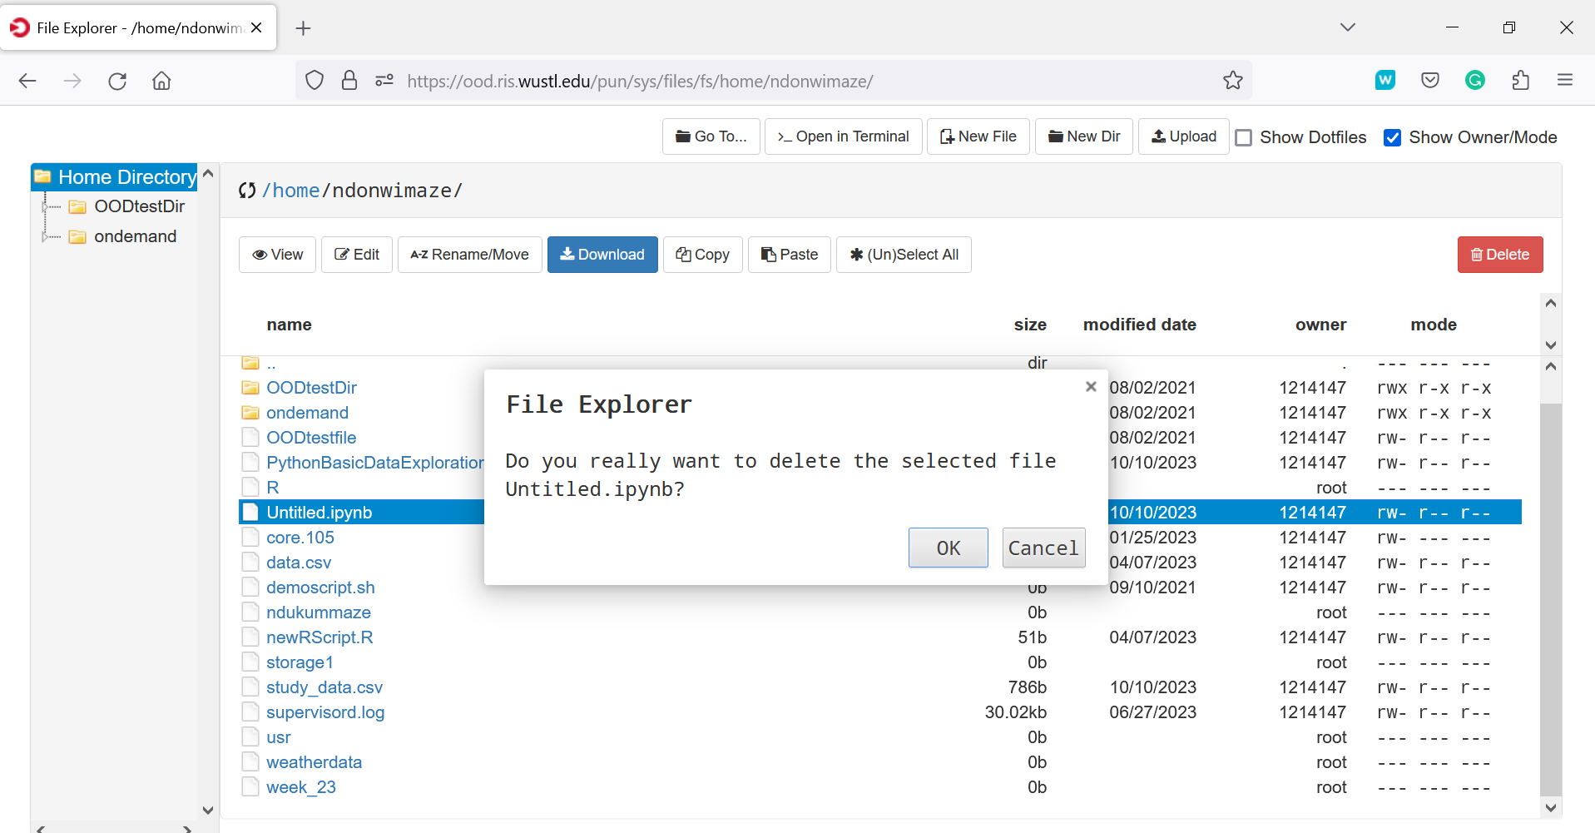
Using ODD on RIS Scientific Compute Platform
Notes:
Can delete files if you have write (w) permissions on the file

Slide 30
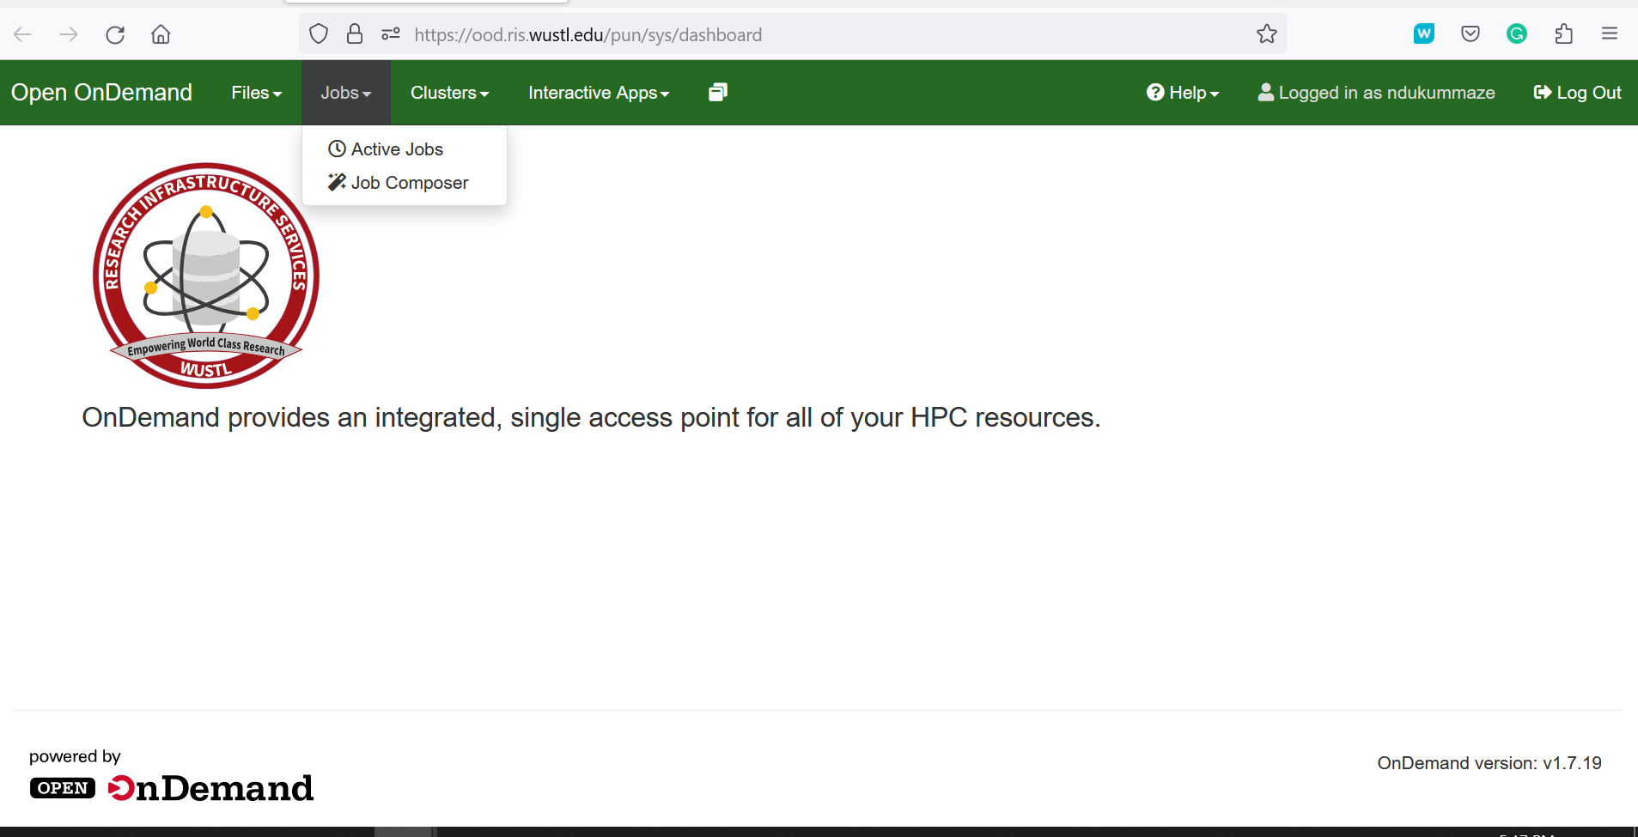
Using ODD on RIS Scientific Compute Platform
Notes:
Jobs
View active jobs
Use Job Composer to create scripts and launch batch jobs
Job Composer
Create and launch batch jobs similar to using a .bsub job file (commands on CLI).
Job and resource parameter information can be found on the Job Execution Examples page in RIS manual.

Slide 31
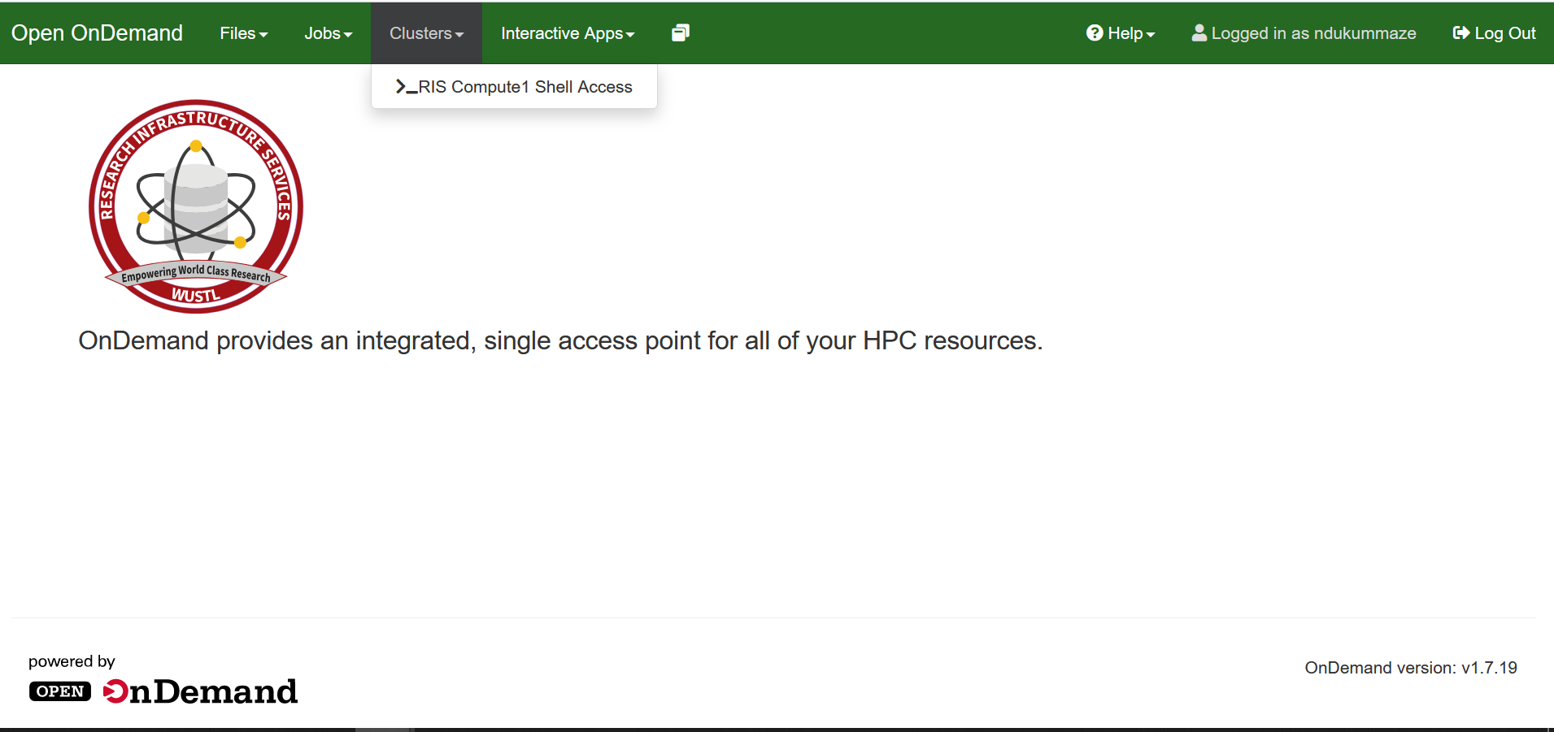
Using ODD on RIS Scientific Compute Platform
Notes:
Clusters
Launch command-line and batch jobs from a terminal session.
Access to all compute1 resources available from this client node.

Slide 32
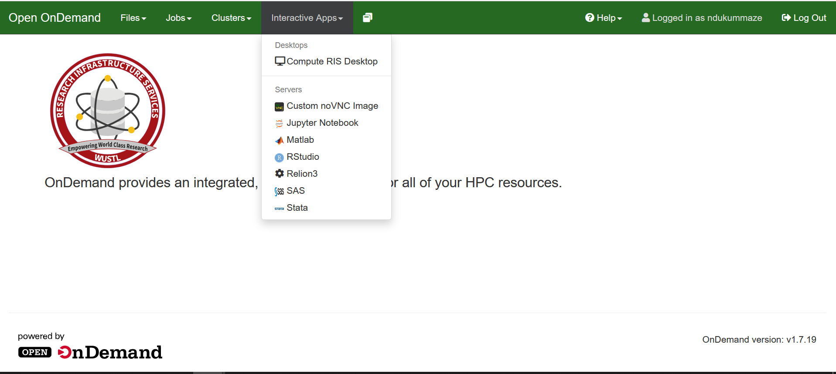
Using ODD on RIS Scientific Compute Platform
Notes:
Interactive Apps:
Run interactive jobs with GUI. - Select application name from the Interactive Apps dropdown. - Configure storage/scratch mounts and resource options for the job. - Select Launch to submit the job.
Custom noVNC Image
Ability to run custom images that specifically leverage the RIS noVNC image via the Custom noVNC Image application. This application also allows for extended resource usage such as spanning multiple hosts jupyter notebook --notebook-dir=.

Slide 33
Using ODD on RIS Scientific Compute Platform
Interactive Apps:
Can start up the Compute RIS Desktop to access a terminal in OOD.
can use the OOD terminal for a more traditional HPC environment, using the module load system to run tasks that need software (R, Python etc.,)

Slide 34
Using ODD on RIS Scientific Compute Platform
Interactive Apps:
Custom noVNC Image application can run custom docker images. Can use one of the RIS noVNC created Docker images to leverage this functionality or use your own docker image
Note that at this time, due to included dependencies and start up scripts, only current RIS noVNC images or images build from RIS noVNC images are guaranteed to work

Slide 35
Using ODD on RIS Scientific Compute Platform
Interactive Apps:
Can start up one of the applications installed (Jupyter, MATLAB, RStudio, Relion3, SAS, Stata)
Select application name from the Interactive Apps dropdown, configure storage/scratch mounts and resource options for the job and click Launch

Slide 36
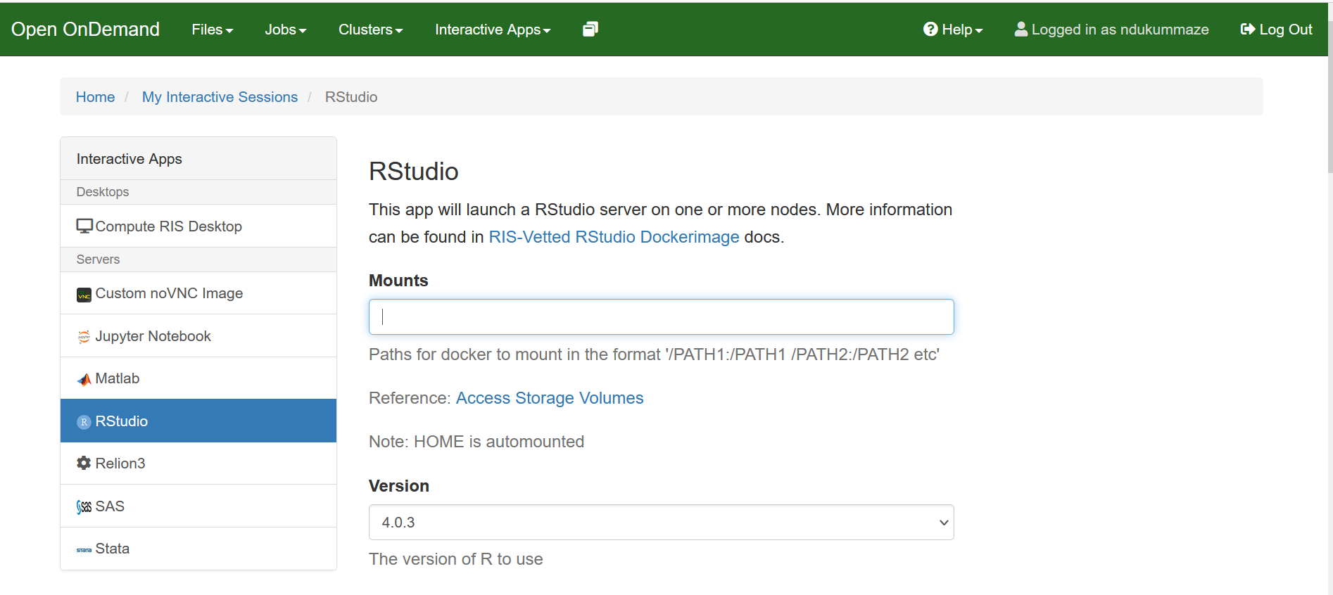
Launch RStudio
Notes:
Select RStudio from the Interactive Apps dropdown, configure storage mount and resource options for the job and click Launch

Slide 37
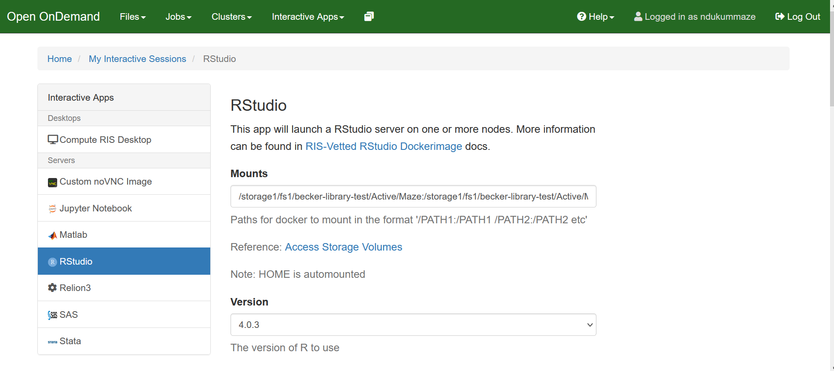
Launch RStudio
Details on form fields: https://docs.ris.wustl.edu/doc/compute/compute-quick-start.html
Notes:
Select RStudio from the Interactive Apps dropdown, configure storage mount and resource options for the job and click Launch

Slide 38
Launch RStudio
User group – choose from the dropdown menu
Maze’s user group: becker-library-test
Mount –for Maze's storage1 allocation:
/storage1/fs1/becker-library-test/Active/Maze:/storage1/fs1/becker-library-test/Active/Maze
Job Group: - Job Group is wustlkey/ood
Maze’s Job group is /ndukummaze/ood
Details on form fields: https://docs.ris.wustl.edu/doc/compute/compute-quick-start.html
Notes:
configure storage mount and resource options for the job and click Launch

Slide 39
Launch RStudio
Queue – queues you have access to, such as general/general interactive
Memory (GB) – the amount of memory or RAM you want to give the job.
Number of hours for job to run:
general queue limit is 28 days or 672 hours
general-interactive queue limit is 24 hours
Number of GPUs and processors – GPUs for your job
Details on form fields: https://docs.ris.wustl.edu/doc/compute/compute-quick-start.html
Notes:
configure storage mount and resource options for the job and click Launch

Slide 40
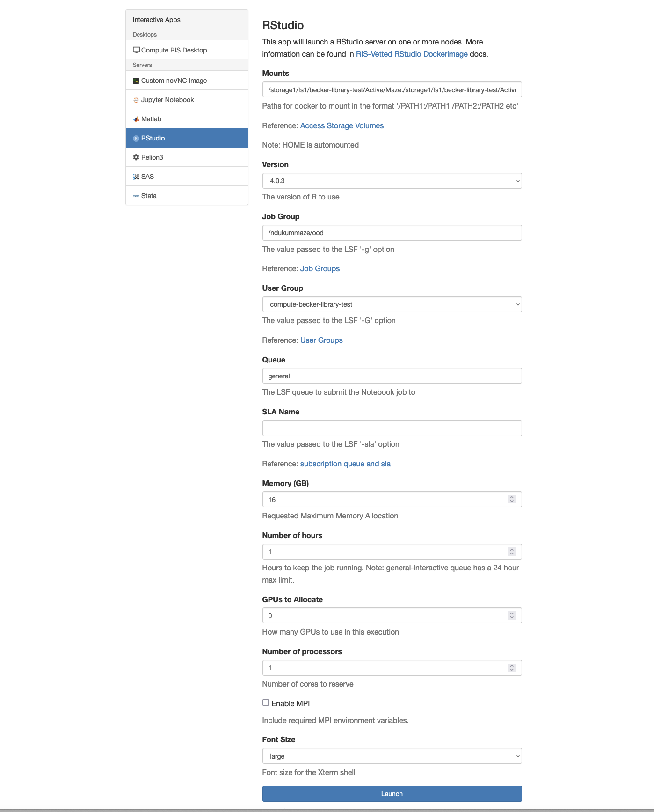
Launch RStudio
Click Launch to submit job
Notes:
configure storage mount and resource options for the job and click Launch
*The MPI options in OOD are for users who are using MPI to run their commands. If you are not using MPI, you can ignore those

Slide 41
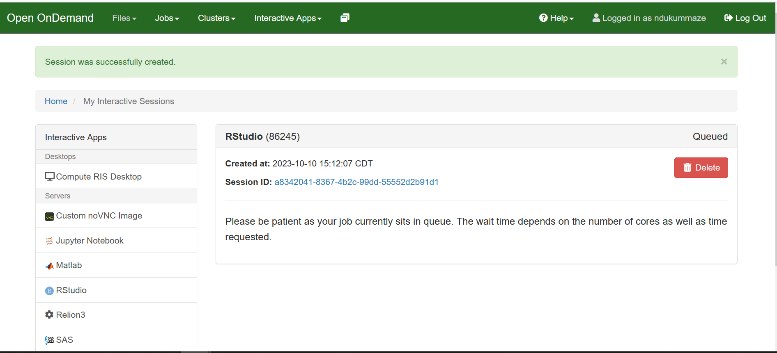
Launch RStudio

Slide 42
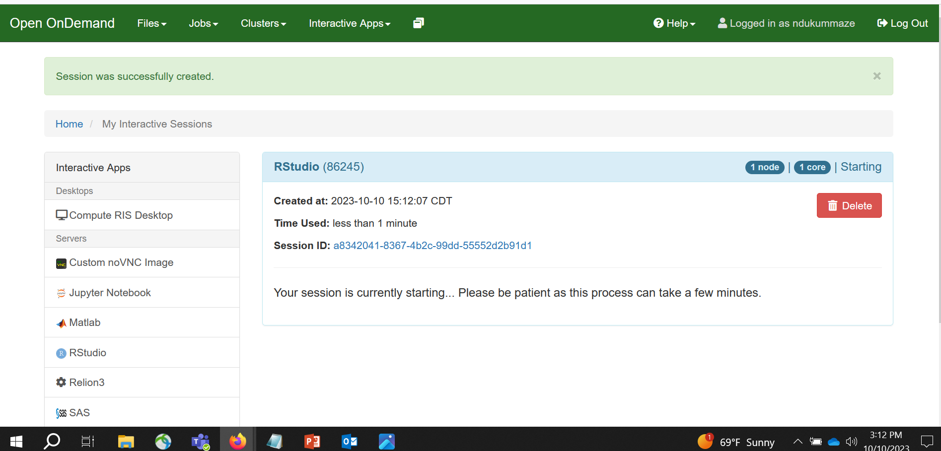
Launch RStudio

Slide 43
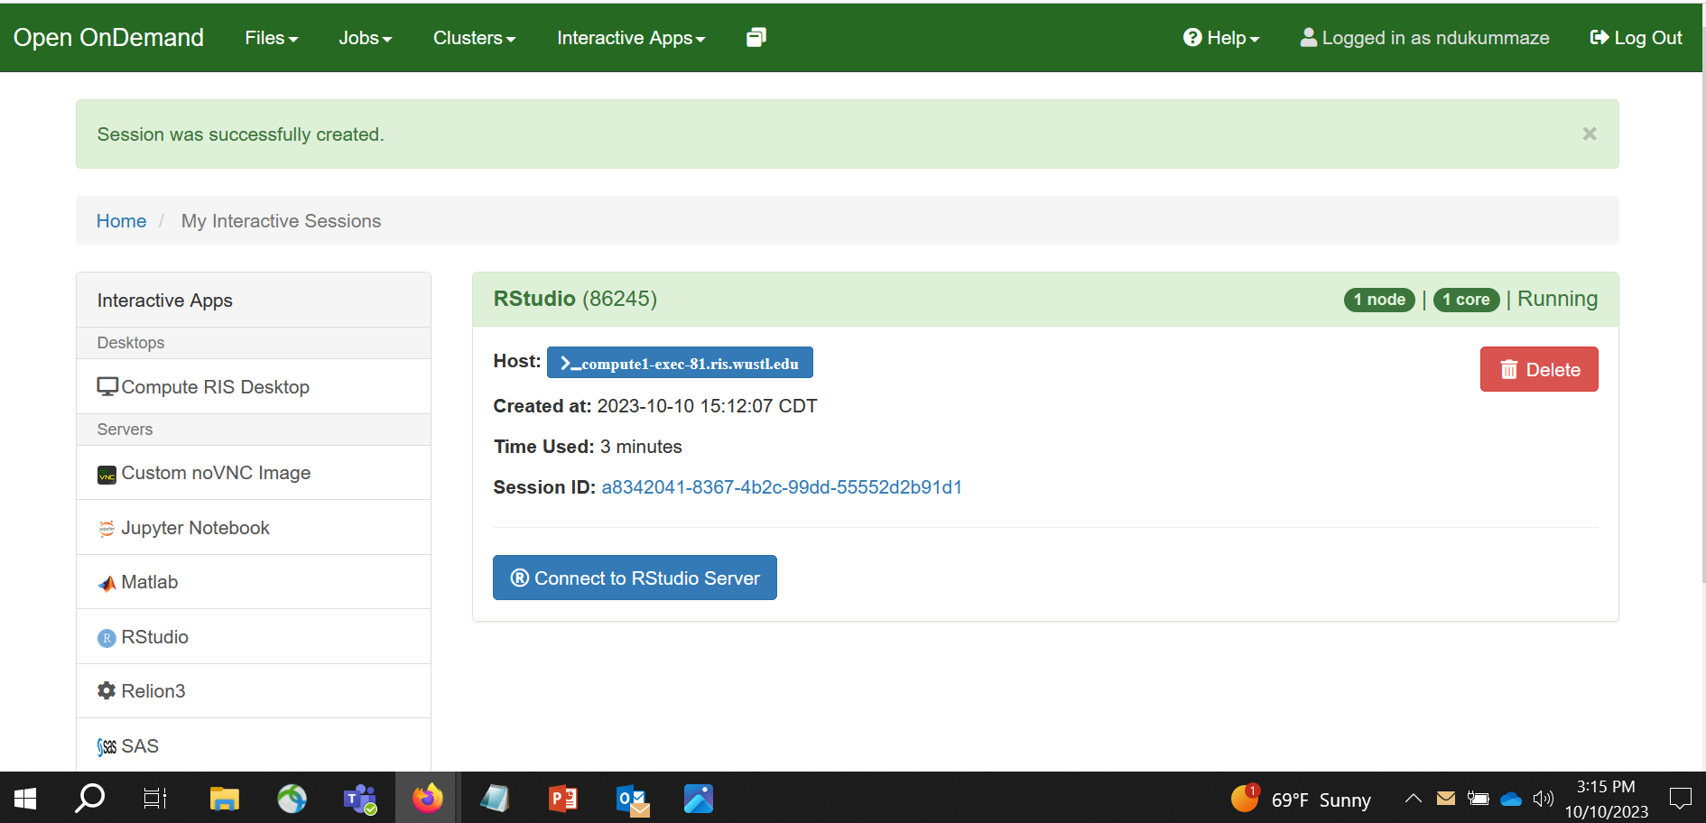
Launch RStudio
Click to open RStudio in a new web browser

Slide 44
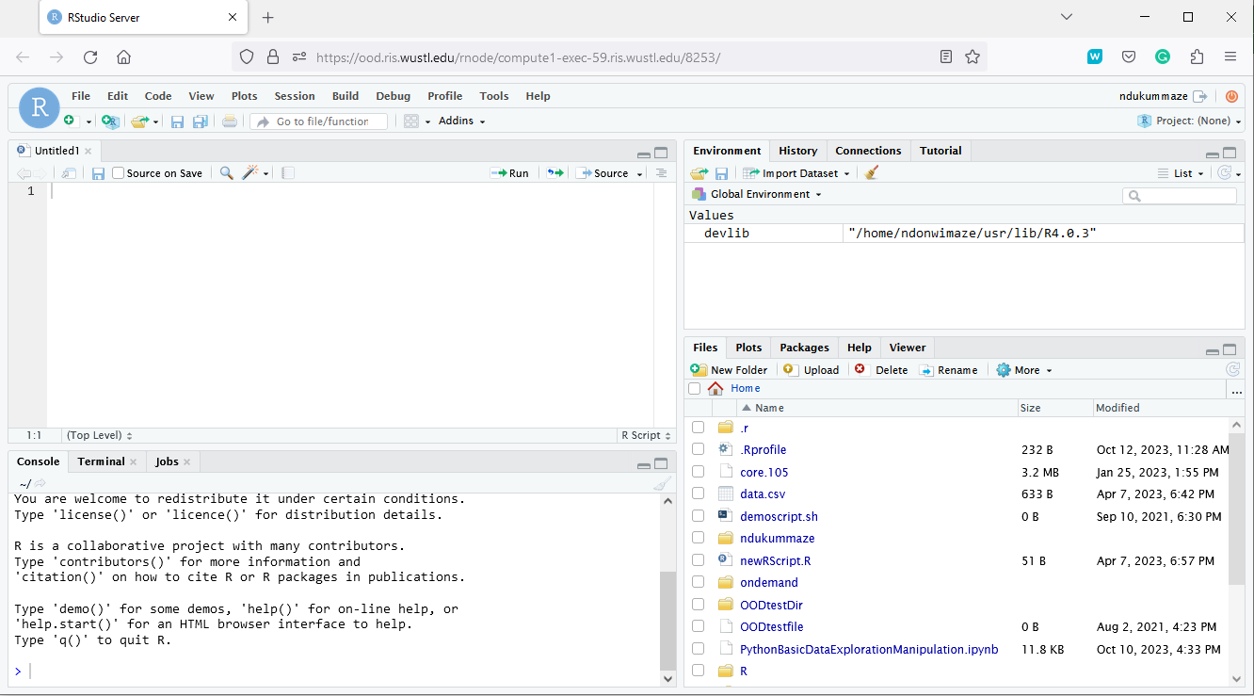
Launch RStudio
Notes:
Default location is you RIS compute home directory
Click the three dots on right to change to a different folder
For example, click the three dots, enter the full path of your directory in storage1, and you can then navigate there

Slide 45
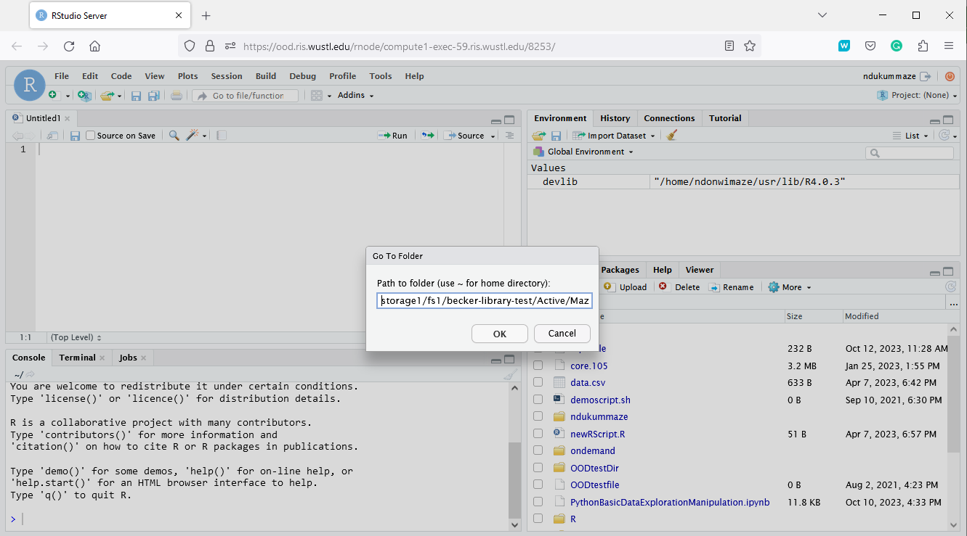
Launch RStudio
Click the three dots to change folders
Notes:
Default location is home directory
Click the three dots on right to change to a different folder
For example, click the three dots, enter the full path of your directory in storage1, you can then navigate there

Slide 46
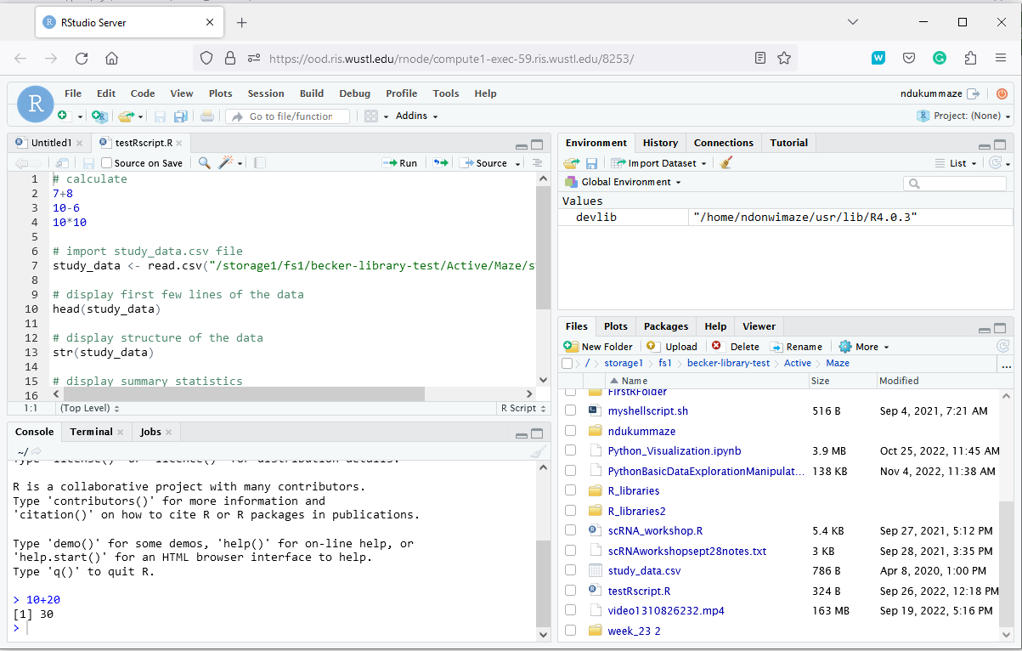
Launch RStudio
Notes:
Default location is home directory
Click the three dots on right to change to a different folder
For example, click the three dots, enter the full path of your directory in storage1, you can then navigate there and run code on data in storage1

Slide 47
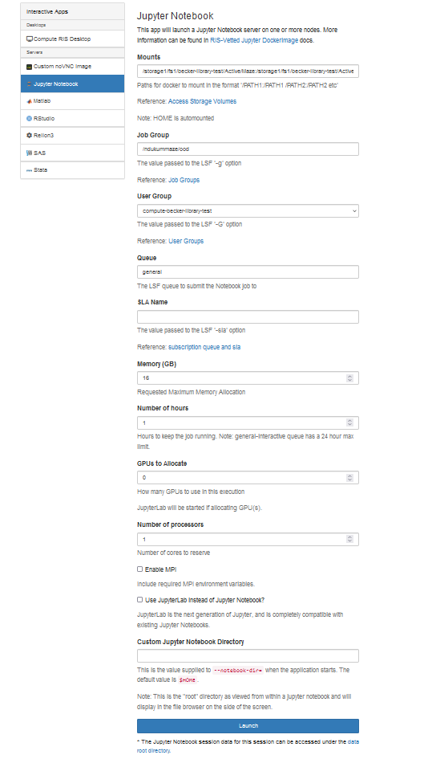
Launch Jupyter
Opens Jupyter notebook in home directory by default
Notes:
Select Jupyter notebook from the Interactive Apps dropdown. Next, configure storage mount and resource options for the job and click Launch

Slide 48
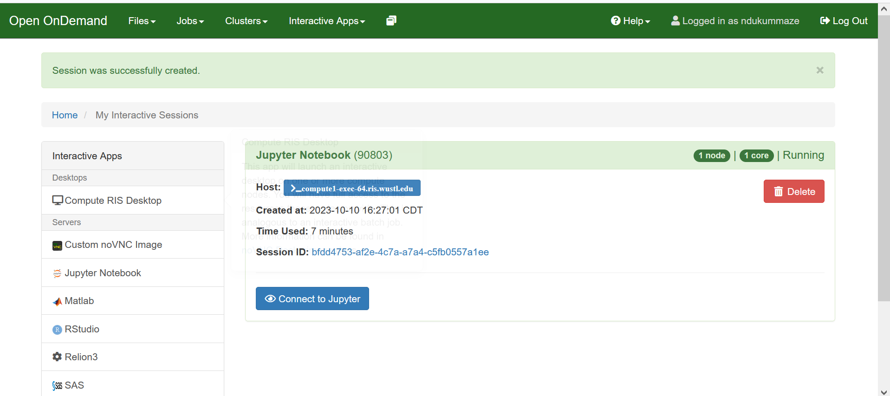
Launch Jupyter Notebook

Slide 49
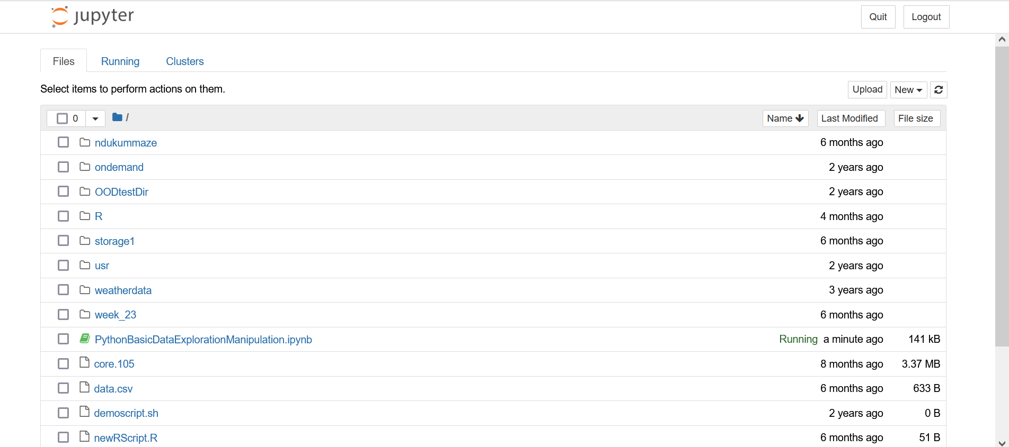
Launch Jupyter Notebook
Notes:
Default location is your RIS compute home directory

Slide 50
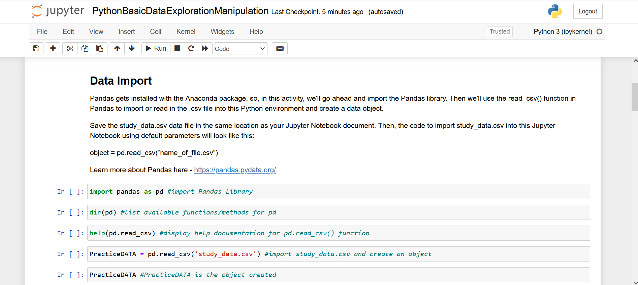
Launch Jupyter Notebook
Notes:
Open a notebook in my home directory

Slide 51
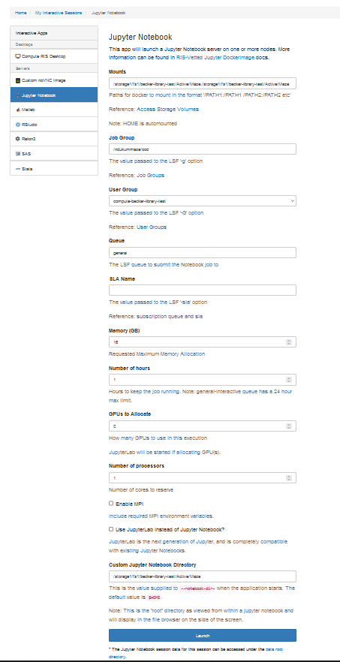
Launch Jupyter
Input a single file path in the “Custom Jupyter Notebook Directory” box to change from the default Home folder.
This path will open in Maze’s storage1 allocation:
/storage1/fs1/becker-library-test/Active/Maze
Notes:
Input a single file path in the Custom Jupyter Notebook Directory box to change from the default Home folder. This path: /storage1/fs1/becker-library-test/Active/Maze - opens in storage1

Slide 52
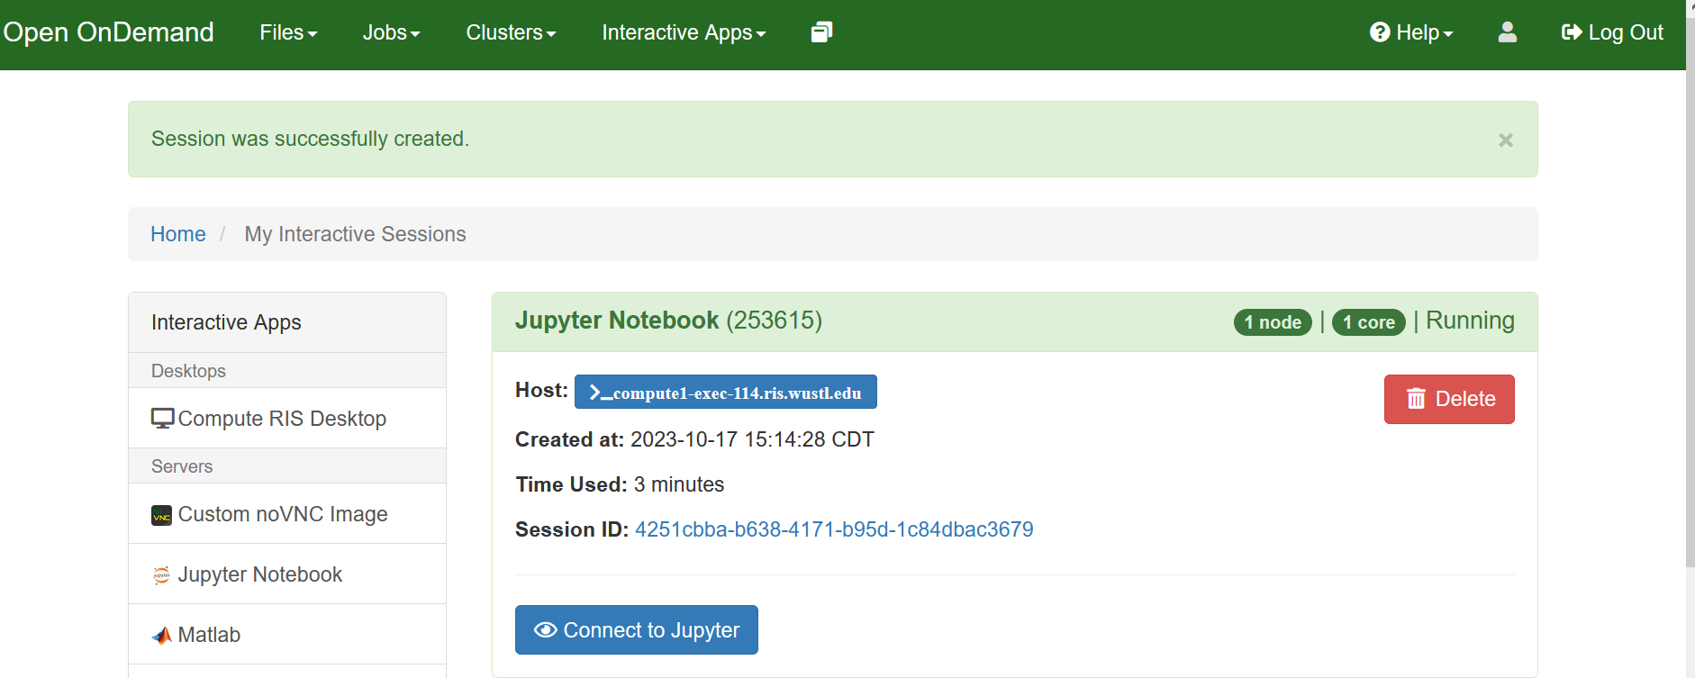
Launch Jupyter

Slide 53
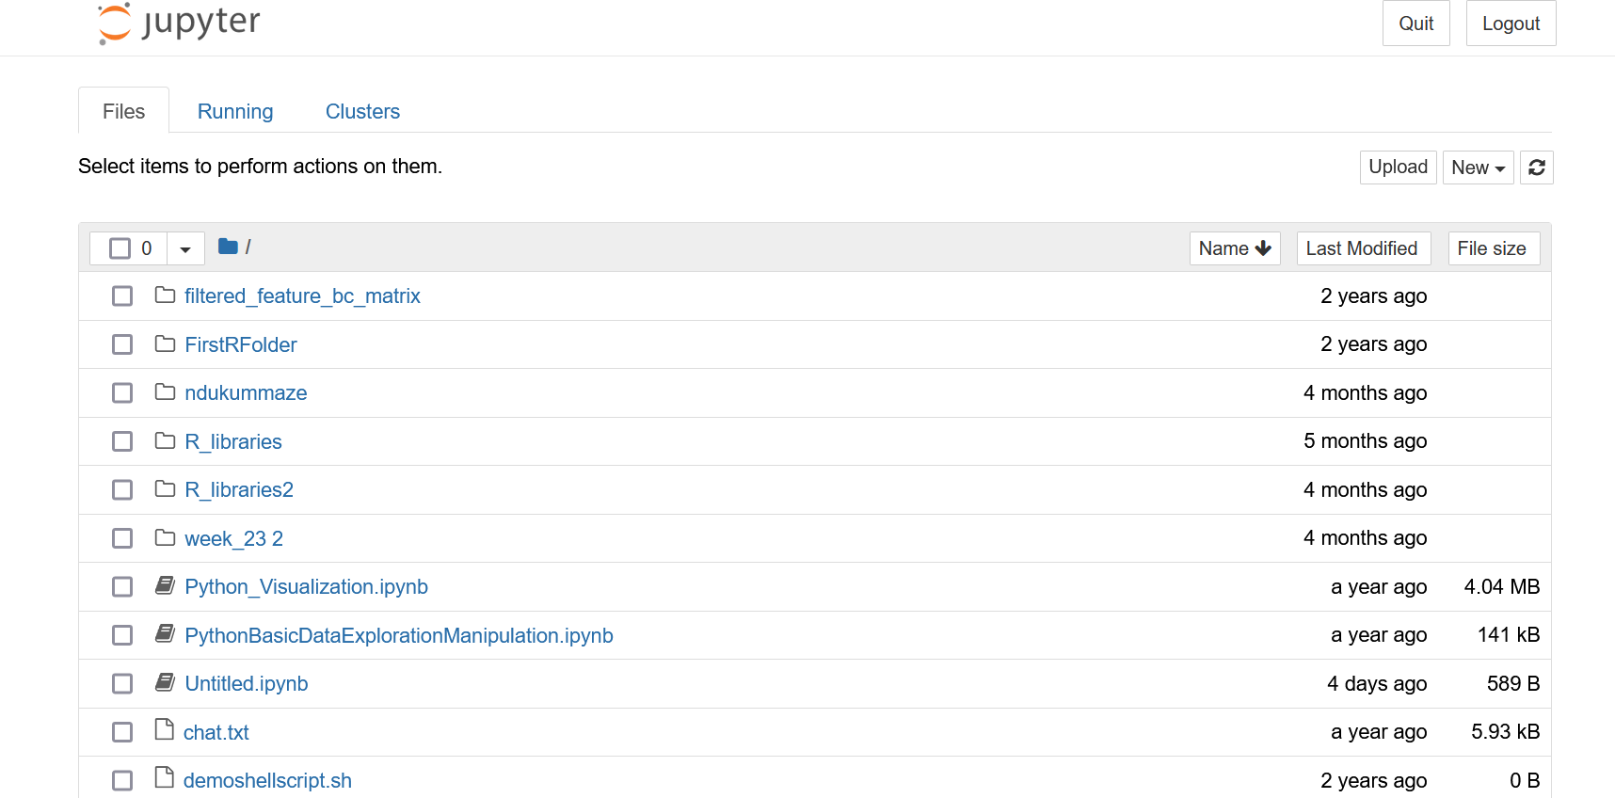
Launch Jupyter
Jupyter opens in storage1
Notes:
Jupyter opens in storage1

Slide 54
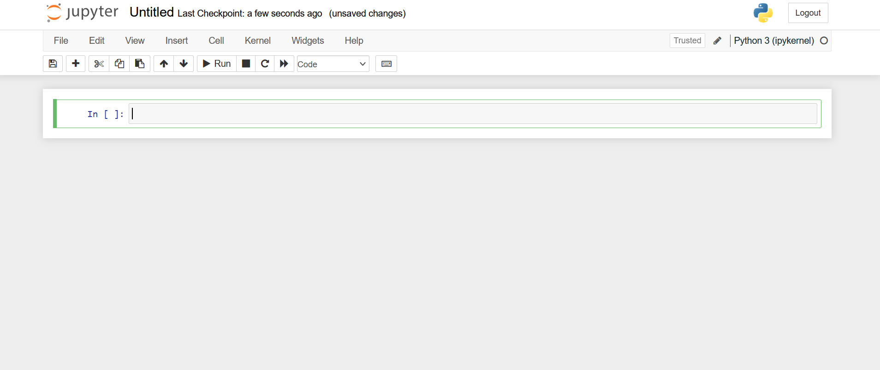
Launch Jupyter Notebook
Can open a new notebook
Notes:
Can open a new notebook

Slide 55
How to get help from RIS
Users have varied needs and diverse use cases, it’s best to speak with RIS Staff about your needs:
Schedule one-on-one at Virtual Office Hours: https://ris.wustl.edu/support/
Create a ticket at Service Desk: https://ris.wustl.edu/support/service-desk/

Slide 56
Demonstrations
1. Connect to RIS compute using ssh protocol on CLI
2. Start RIS OOD, launch interactive apps:
RStudio
Jupyter Notebook
Compute RIS Desktop

Slide 57
Additional Helpful Resources
Bioinformatics Workshop Series (bfx) at WUSM Campus:
Computing basics is beginner level education. For additional in-depth training if appropriate for your needs, visit https://github.com/genome/bfx-workshop
The bfx lectures are recorded and participants can join anytime throughout the year
Notes:
Workshops occur in the Fall and Spring. To view the Fall 2023 schedule and the Spring 2024 topics, visit https://github.com/genome/bfx-workshop.

Slide 58
Additional Helpful Resources
RIS Services User Manual – https://docs.ris.wustl.edu/
RIS Open On Demand - https://docs.ris.wustl.edu/doc/compute/compute-ood.html
Open On Demand - https://openondemand.org/
Becker’s Research Computing workshops page – https://becker.wustl.edu/services/research-computing/
O’Reilly/Safari Tech Books Online – access through Becker Library using your WashU email https://learning.oreilly.com/home/
LinkedIn Learning for WUSTL - https://it.wustl.edu/home/how-to/linkedin-learning/
Google
RIS Support: https://ris.wustl.edu/support/
RIS contact : elyn@wustl.edu
Becker Library Contact: ndukummaze@wustl.edu

